Slide 1
NBA MONEYBALL

Slide 2
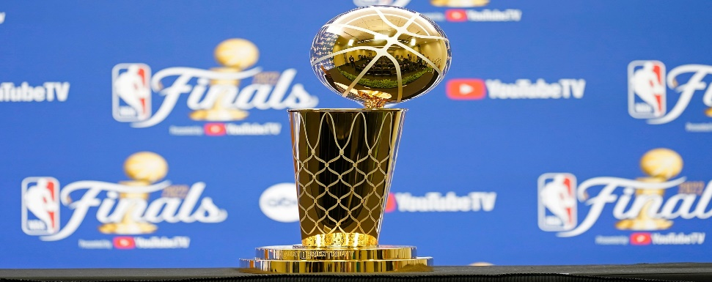
2023 NBA Finals *MVP Predictor *Winning Team

Slide 3

Machine Learning Models: * Linear Regression (MVP prediction) * Random Forest Regressor (Team Game predictions)
NOTE:
To change images on this slide, select a picture and delete it. Then click the Insert Picture icon
in the placeholder to insert your own image.

Slide 4
2023 NBA FINALS MVP PREDICTOR
Linear Regression machine learning model
Exclusively based on NBA Finals Player Data (per game)
Weighted heavily on Versatility Index and +/- data
MVP Prediction: Nikola Jokic!!!!

Slide 5
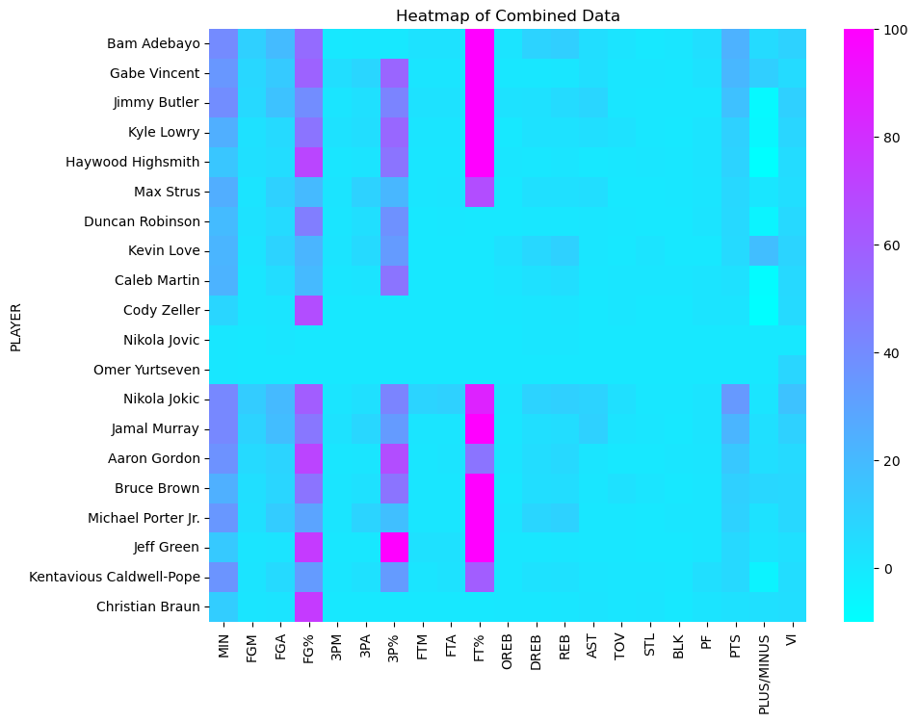
Content with Caption Layout

Slide 6
Two Content Layout with Table
First bullet point here
Second bullet point here
Third bullet point here
Class | Group 1 | Group 2
Class 1 | 82 | 95
Class 2 | 76 | 88
Class 3 | 84 | 90

Slide 7
Add a Slide Title - 1

Slide 8
Add a Slide Title - 2

Slide 9
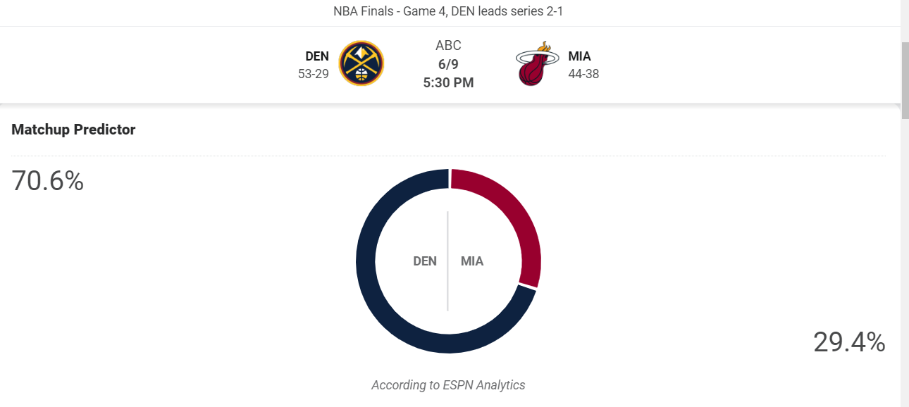
Game 4 predictions: results, comparison & potential payout

